Slide 1
Tic Tac Toe Game Implementation
Using Digital Logic Circuit Design
Submitted to ->
Nafis Sadik
Sadat Tahmeed Azad
Submitted by ->
Group 07 Members:
1906055 Tasmin Khan
1906056 Bokhtiar Foysol Himon
1906059 Hasib Ur Rashid Ifti
1906065 AKM Anindya Alam

Slide 2
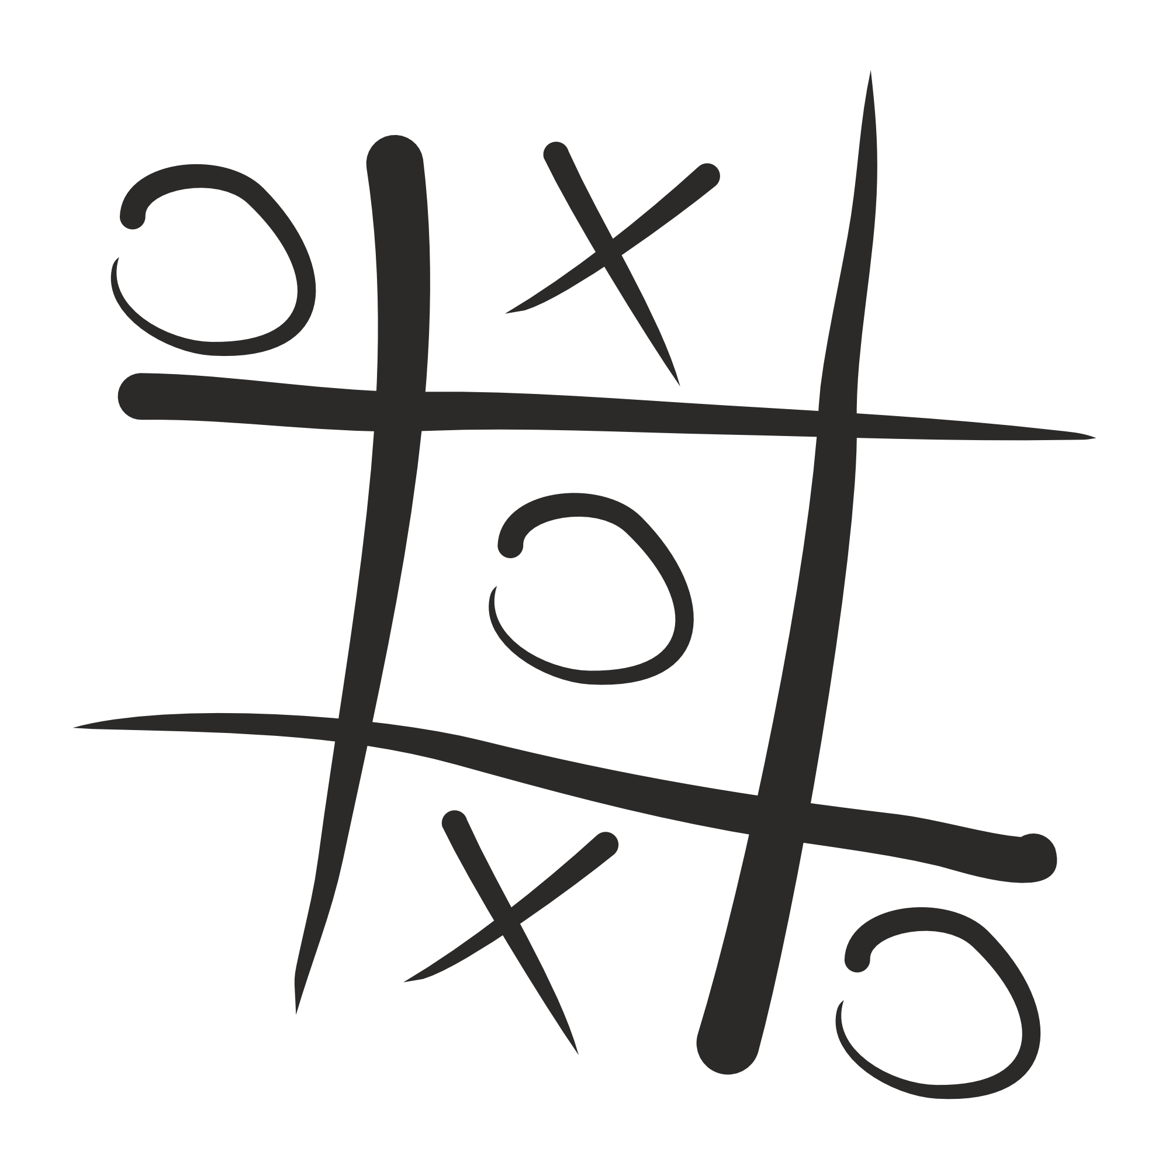
Project Background
Tic Tac Toe is a popular turn-based game where players mark X or O symbols on a grid. This project aims to create an electronic version using digital logic circuits. The goal is to develop a lucrative system that enables players to engage in the game.

Slide 3
Gameplan
01
02
03
04
05
Memory is stored for each move. Once played, the same slot can not be played again.
Players will interact with
a 9*9 push button board to play the move.
LED lights up for each move. Different color is used for different player.
If all the slots are played but no one wins, the game declares draw.
If any winning position is achieved, the game stops.

Slide 4
Logic development
1
2
3
4
Valid input from players
Input storage
Player identification
Condition checking
Inputs are made invalid after a player wins using AND gate and winning output.
Input is taken only once from an individual push button and stored using flip-flop combination
Odd number of inputs and Even number of inputs are separated using XOR gate
Preset 8 winning combinations are checked to see if any player has won.

Slide 5
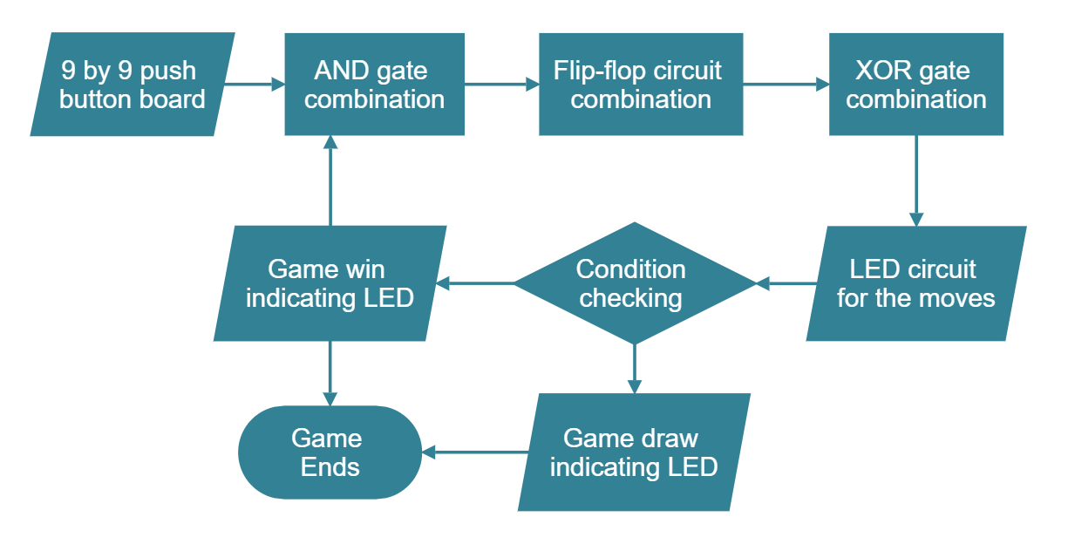
Block diagram

Slide 6
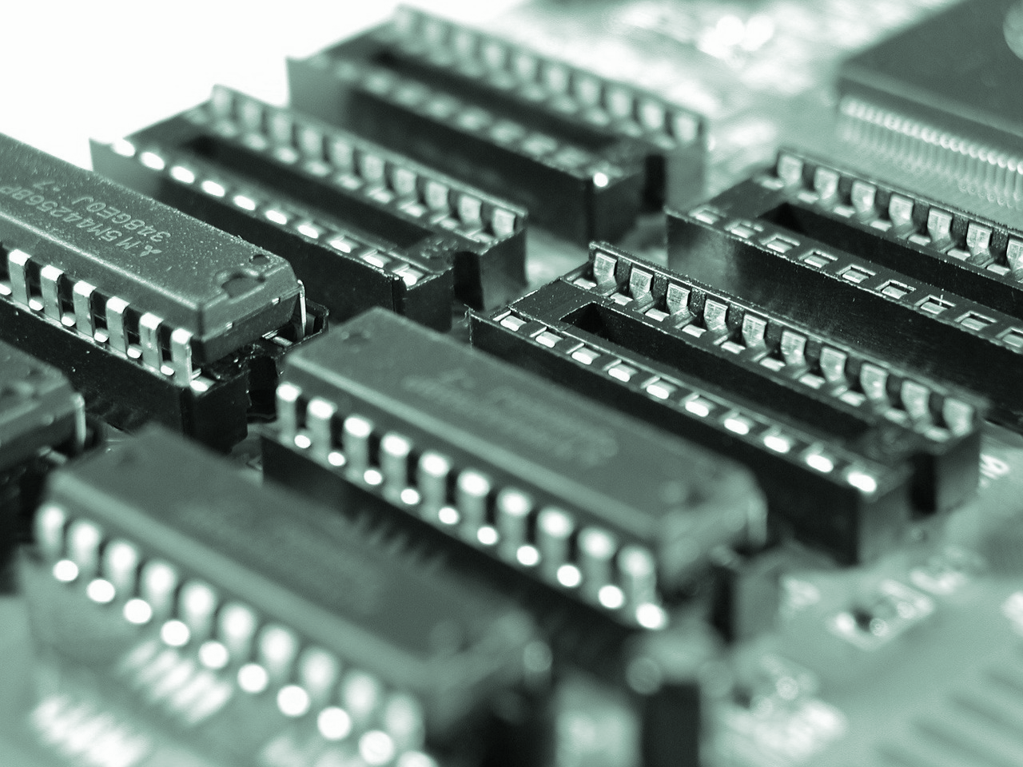
Hardware Requirements
2 Input AND gates (7408)
3 Input AND gates (7411)
4 Input OR gates (4072)
2 INput XOR gates (7486)
1 Input NOT gates (7404)
D-flip-flops (4073)
Bi-color-LED (red/yellow)
SIngle color LEDs
Push buttons

Slide 7
Software Requirements
For simulation and circuit design, we will be using Proteus. After that PCB design will be implemented using the same software. FInally, we will solder necessary ICs and components for final execution.

Slide 8
Questions ?

